Slide 1
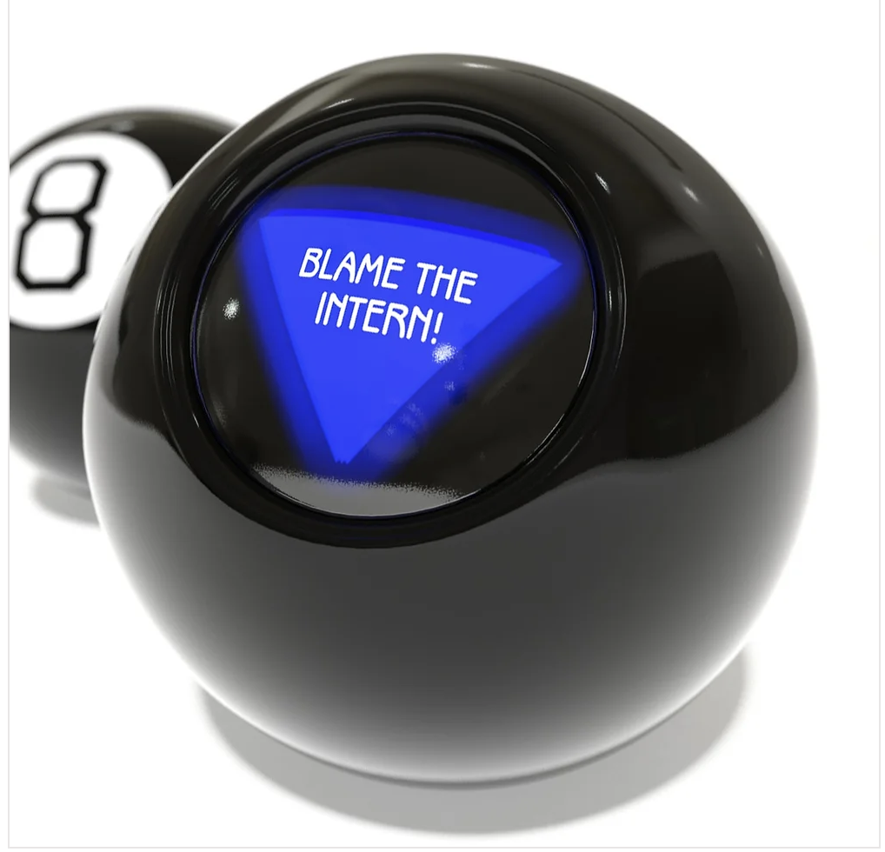
Magically Magic 8 Ball
Kaiti Holcomb
Imani Ford
https://github.com/imaniford98/Magic-8-Ball
The magically magic 8 ball is so special because fortune tellers aren’t the only ones who can use it. People who are in magic industry can use it as an act to draw the crowd’s attention even more. You can say not every magic 8 ball is like this. This magic 8 ball will predict an answer for your question or statement

